Slide 1
Manual Inputs - Flowcharts and Schematics
Data Analysis Architecture – Folder Structure
22 February 2018

Slide 2
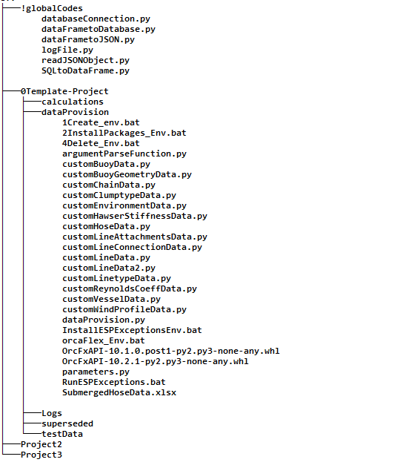
Folder Structure (GSY)
0119 Programming\009 PythonOrcaFlex\Root
Global shared codes
Calculations
Data provision and output
For development,
testing etc. i.e. pre-production
Projects

Slide 3
THANK YOU
For the opportunity to serve

Slide 4
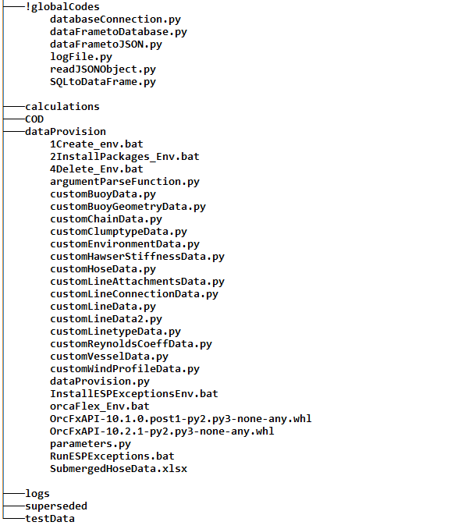
Folder Structure (GSY)
0119 Programming\009 PythonOrcaFlex\OrcaFlex-Temp-Project
Global shared codes
Calculations
Code
Data provision and output
For development,
testing etc. i.e. pre-production

